Slide 1
Introductory General Chemistry
Chemistry 3A
S. M. Halloran

Slide 2
Chemical Equilibrium
Collision Theory
Reaction Rates
Dynamic Equilibrium
The Equilibrium Constant
Le Chatelier’s Principle
Special Types of Equilibria

Slide 3
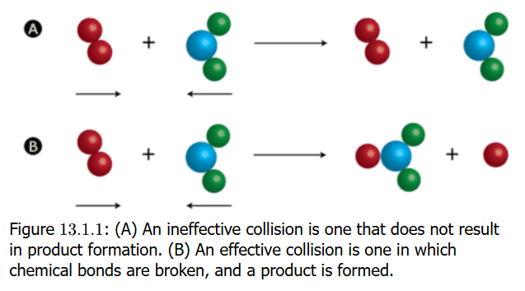
Collision Theory
Collision Theory: proposes that reactant particles colliding with each other form products but under two condition
That there is enough kinetic energy to cause a reaction
That particles are in a proper orientation for a reaction to occur

Slide 4
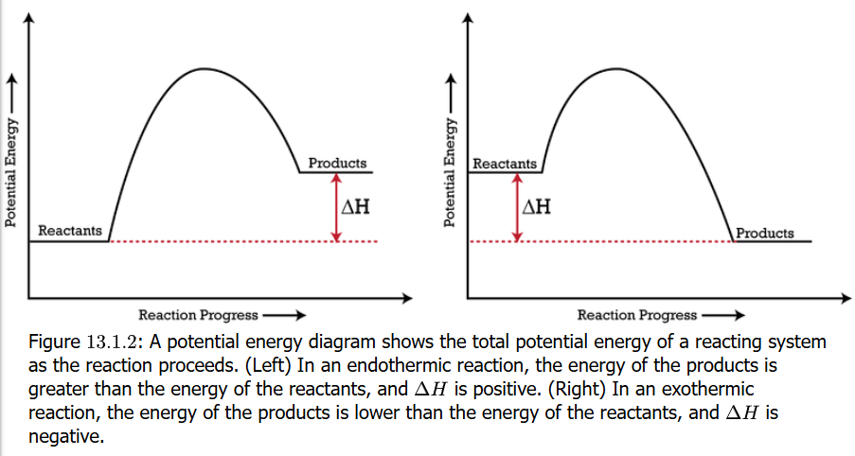
Potential Energy Diagrams
Also called reaction progress curve
Potential energy diagrams show change in potential energy of a system as the reactants become products
The energy change is shown by change in enthalpy ΔH
If ΔH > 0 (products higher than reactants), the reaction is endothermic. If ΔH < 0, the reaction is exothermic

Slide 5
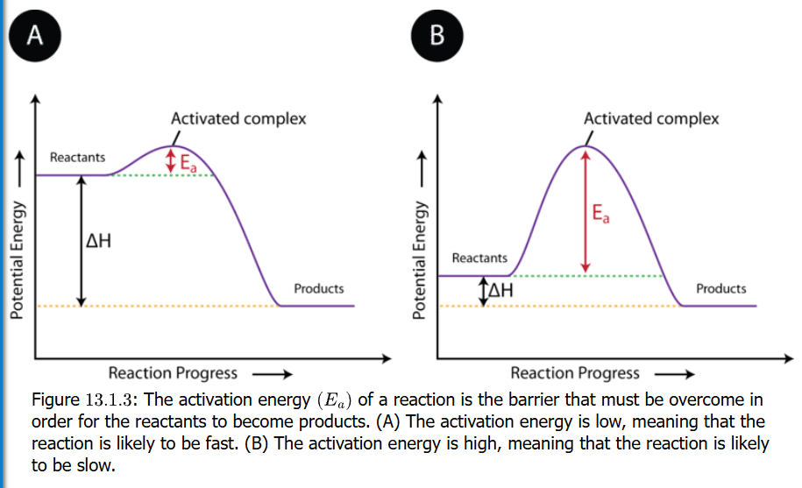
Activation Energy
Reactant particles will collide, but not all collisions result in the chemical reaction
But when collisions happen that have enough energy—activation energy—to occur, reactants will become products by forming an activated complex

Slide 6
E_{a} for Fast or Slow Reactions
The activation energy is symbolized as E_{a}
On the reaction progress curve, it is a “hump” in the curve representing the increase in energy above the PE of the reactants, whether the reaction is endo- or exothermic
If the hump is small, the reaction is likely to be fast. If hump is large, the reaction is likely to be slow

Slide 7
The Activated Complex
When collisions lead to reactions, an activated complex forms as unstable arrangement of atoms that exists momentarily at the peak of the activation energy barrier
The momentary part cannot be imagined how fast it is:
10^{–13} s (one-tenth of a picosecond). An eye blink is one tenth of a second, so the reaction in one trillion times faster
(lasers can be used to determine time)

Slide 8
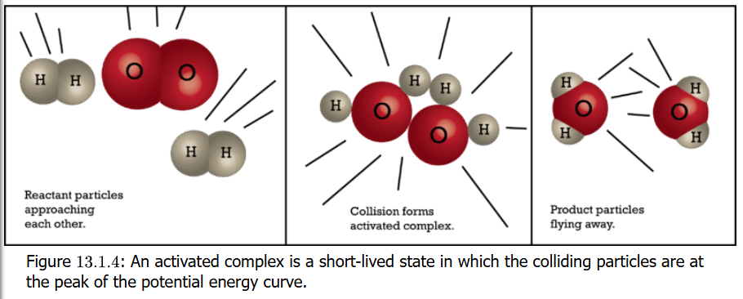
Activation Complex
A note about the provided text:
Book shows this visual of a reaction of 2 H₂ + O₂ → 2 H₂O but that is absolutely not considered to be the mechanism of how this happens. The reaction is in fact a multi-step mechanism. The details are beyond scope of Chem 3A.

Slide 9
Reaction Rates Factors: Temperature
(i) Collision frequency, (ii) collision energy, and (iii) geometric orientation are factors in a successful reaction
Temperature affects collision frequency
Temperature affects average velocity, and velocity is a factor in kinetic energy. Particles collide more frequently
But temperature directly affects activation energy E_{a}
Keeping environments cold versus warm versus hot is understood to control chemical reactions that, for example, might lead to preservation or spoilage of food

Slide 10
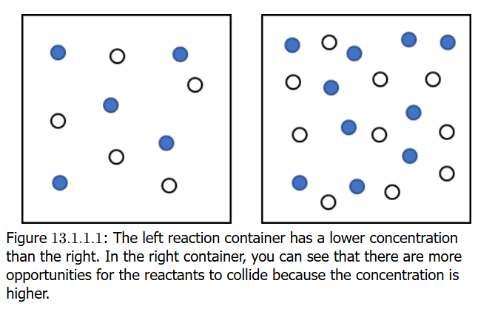
Concentration as a Factor
Reactions are also affected by concentration
Higher concentrations imply particles (molecules, etc) are closer together, more densely arranged, with a higher probability of collisions
If a concentration doubles, so would the reaction rate also double
Combustion involves a flammable
substance and oxygen. If splint
of wood set on fire and fire blown
out, the splint continues to glow.
If splint put in chamber with no
O₂, the wood stops burning
(glows dissipates). But if put
in 100% O₂ chamber, it burns
brighter and hotter. This affects
shows concentration or reactants.

Slide 11
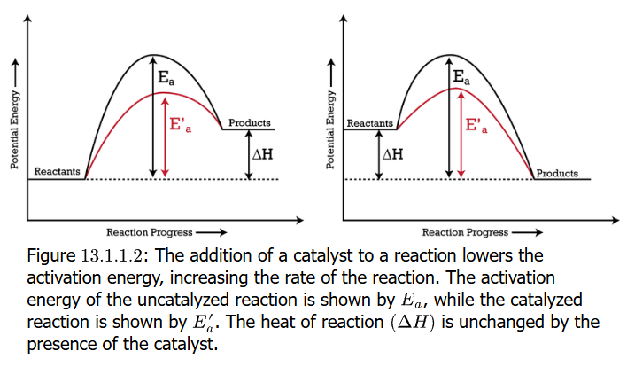
Catalysis and Catalysts
Catalysis is the process by which rate of chemical reaction is changed (usually increased) through the action of a catalyst
A catalyst is a substance that increases rate of a chemical reaction without being consumed or permanently altered in the overall reaction
The effect of catalysis is seen in the reaction progress curve as a lowering of the activation energy Ea, which enables reactants to get over
the energy barrier in
the reaction

Slide 12
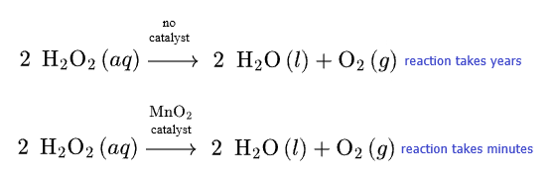
Catalysis Example
Hydrogen peroxide (H₂O₂) is a well-known effective disinfectant. A 3% solution stores well for a few years, but it eventually degrades to water and oxygen products
Just a small amount of manganese(IV) oxide (MnO₂) will accelerate the reaction to where it degrades within minutes

Slide 13
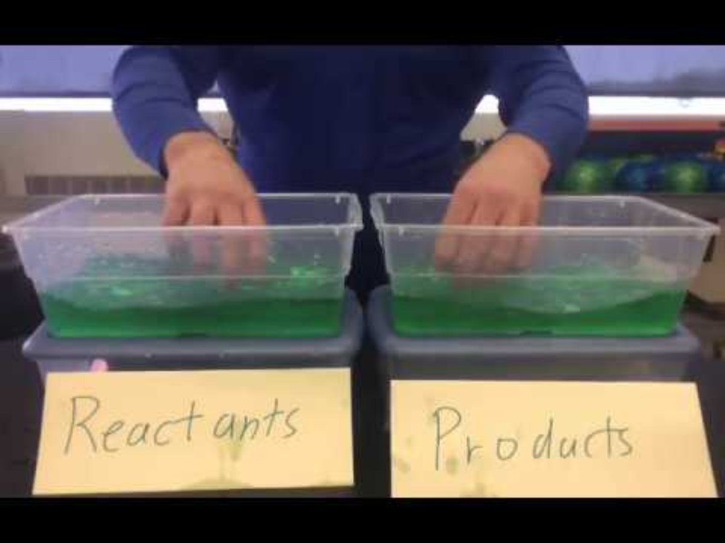
Chemical Equilibrium
Chemical reaction rates (kinetics) were addressed in the previous slides
This addresses the concept of chemical equilibrium, of reactants in initial conditions with no products, and of reactions showing products now becoming reactants in a reverse of the direction of the reaction

Slide 14

Reversible Reactions
The $⇌$ symbol/character was previously to indicate the state of equilibrium, the concept that chemical reactions often have a forward and reverse of the reaction
The formation and decomposition of hydroiodic acid (hydrogen iodide) [HI] is an example of the reaction going both ways
$$H2+I2→2 HI (forward) \\ 2 HI→H2+I2 (reverse)$$
$$H2+I2⇌2 HI$$

Slide 15
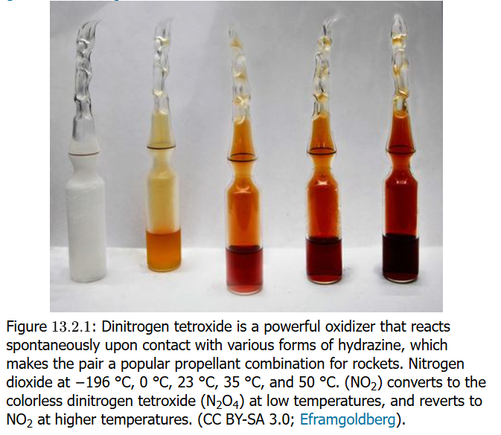

Dynamic Equilibrium
$$\left[colorless\right] N2O4 \left(g\right)⇌2 NO2 \left(g\right) \text{[}\text{red}\text{−}\text{brown}\text{]}$$
The forward and reverse directions of the reaction are shown
$$N2O4 \left(g\right)→2 NO2 (g)$$
$2 NO2 (g)$ $→N2O4 \left(g\right)$
N₂O₄ is colorless and NO₂ is reddish-brown so a reaction can be monitored visually

Slide 16
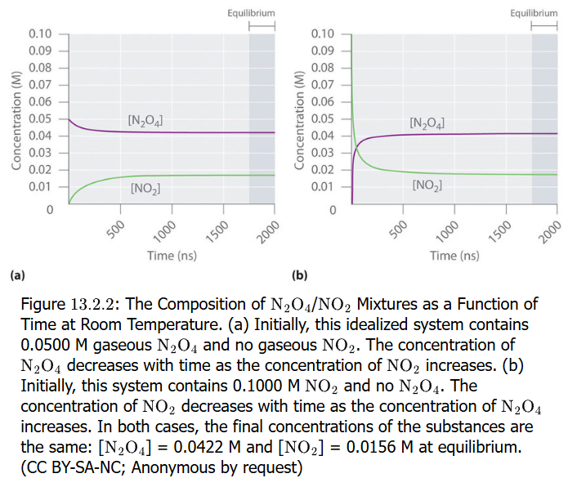
Example of Dynamic Equilibrium
Equilibrium is shown as the change in concentration of reactant and/or product over time
One can start with no (zero) concentration of product (for forward reaction) or of reactant (for reverse direction this become
the product) and follow
change in amount or
concentration over
time
Eventually a plateau is
reached where
concentration of
neither reactant or
product changes
This is equilibrium

Slide 17
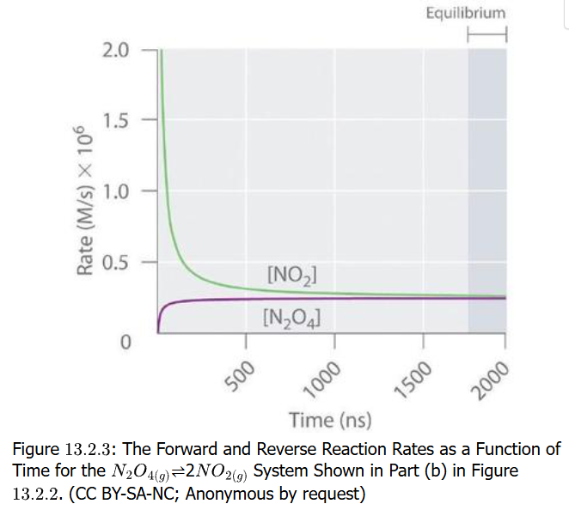
Change in Rate of Reaction
In the plot shown, it shows not amount or concentration, but rather the rate of the reaction versus time. A rate of reaction is the function of the concentration (molar, M) per unit time
Initially the sample is
pure red-brown NO₂
and will form colorless
N₂O₄
As N₂O₄ product forms,
the rate slows and
eventually levels off to
a constant rate while
the reverse reaction
increases to a level rate as
well

Slide 18

Rate of Reaction Equation
The (forward) reaction rate, which is the dimerization of NO₂, has a mathematical expression:
$forward rate=\frac{d[NO2]}{dt}=kf\left[NO2\right]\left[NO2\right]=kf\left[NO2\right]2$
$$reverse rate=\frac{d[N2O4]}{dt}=kr\left[N2O4\right]$$
The details of rate equations are beyond
the scope of this course but are
mentioned here only because
the textbook references these equations

Slide 19
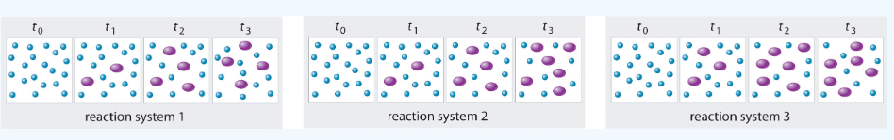

Practice: Equilibrium
In the illustrated three reaction systems, what is the relative time to reach chemical equilibrium where $2 A⇌B$? A=small blue dot, B = large purple dot
Systems 1 and 3 show A decrease from t₀ to t₂, with t₂ and t₃ having no change; thus at equilibrium by t₃
System 2: A and B still changing between t₂ and t₃, and this system may not have reached equilibrium

Slide 20
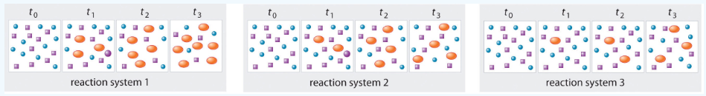

Practice: Equilibrium
Another three reaction systems shown, where
$A+B⇌C$ which system(s) has reached equilibrium?
A=blue circles, B = purple squares, C=orange ovals
System 2: the t₂ and t₃ time frames have 4 orange ovals and the count of the reactants should be same
The other systems would need to reflect no changes between the last two time frames to demonstrate equilibrium, and they do not.

Slide 21

Equilibrium Constant Equation
Studies of chemical reactions with forward and reverse directions showed this pattern
$$aA+bB⇌cC+dD$$
The equilibrium can be expressed as a constant in this equation, known as the law of mass action
$$K=\frac{\left[C\right]c\left[D\right]d}{\left[A\right]a\left[B\right]b}$$
Features of equation
Products are in numerator, reactants are in denominator
Brackets express concentration in molarity (units = molar)
Expression is a quotient of products (multiplication)
Coefficients of reaction are exponents in the expression (if coefficient = 1, no exponent needed)
Solids, liquids, solvents have value = 1, so they have no effect on equation

Slide 22
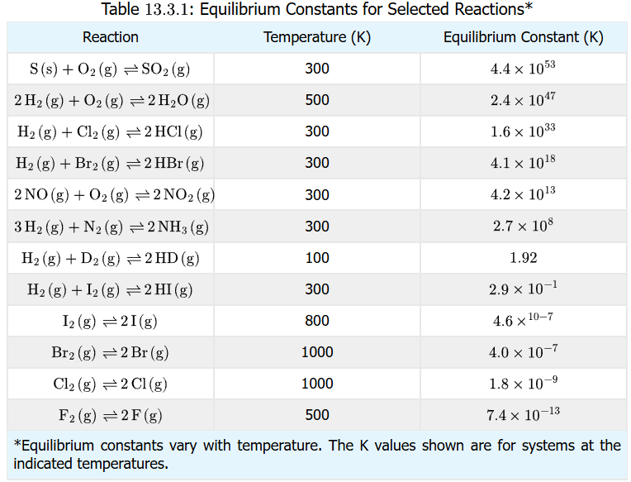
Equilibrium Constant Expression
Temperature
Concentration
Catalysts

Slide 23
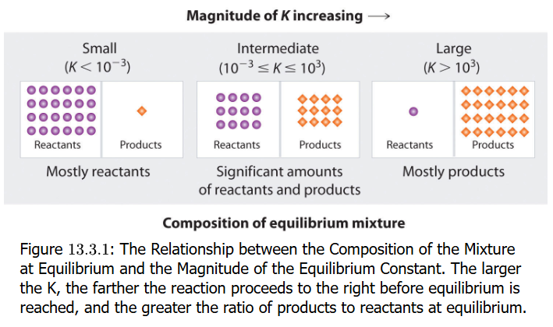
Equilibrium Constant Expression
Temperature
Concentration
Catalysts

Slide 24
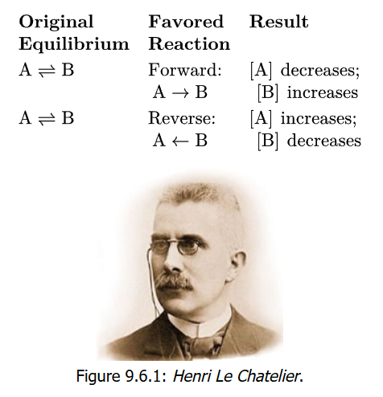
Le Chatelier’s Principle
Temperature
Concentration
Catalysts

Slide 25
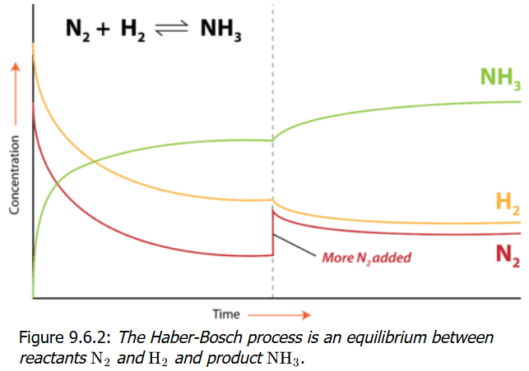
Le Chatelier’s Principle
Temperature
Concentration
Catalysts

Slide 26
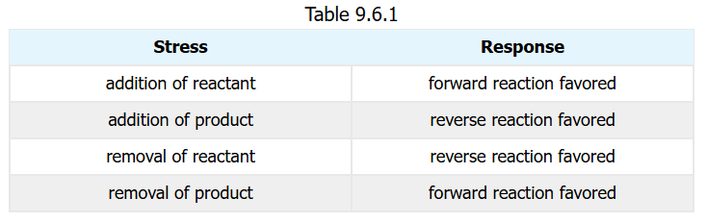
Le Chatelier’s Principle
Temperature
Concentration
Catalysts

Slide 27
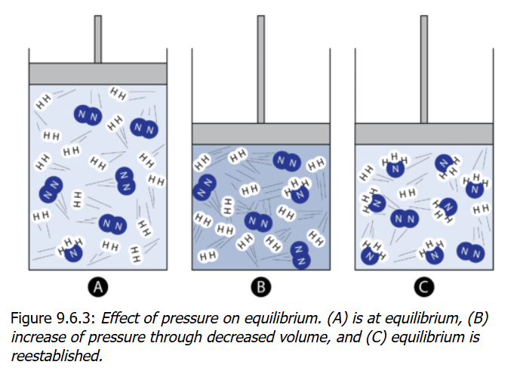
Le Chatelier’s Principle
Temperature
Concentration
Catalysts

Slide 28
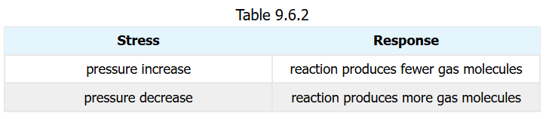
Le Chatelier’s Principle
Temperature
Concentration
Catalysts

Slide 29
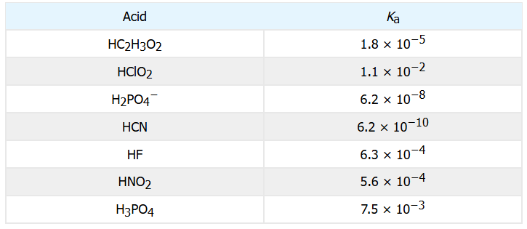
Special Types of Equilibria
Temperature
Concentration
Catalysts

Slide 30
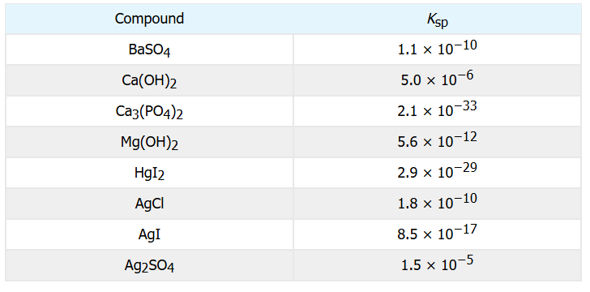
Special Types of Equilibria
Temperature
Concentration
Catalysts

